Slide 1
LIFE INSURANCE PORTAL
TEAM 02 – ABEEL DHEEN R S
ABINAYA K
HARIKARAN S
KISHORE M

Slide 2
What is life insurance
Insurance is a financial arrangement where you pay premiums to an insurer in exchange for protection against potential financial losses or risks, such as accidents, illness, or property damage.
Life insurance is a financial contract that provides a lump-sum payment to beneficiaries upon the policyholder's death.

Slide 3
ADVANTAGES
Provides Financial Security:
Ensures your loved ones are financially protected in your absence.
Covers Debt Obligations:
Pays off outstanding debts like mortgages and loans.
Offers Income Replacement:
Helps maintain your family's standard of living after your death.
Supports Estate Planning:
Facilitates the smooth transfer of assets to beneficiaries.

Slide 4
LIFE INSURANCE PORTAL
OBJECTIVE
To provide users with an online platform to manage life insurance policies efficiently.
It allows users to view, purchase, update, and track their insurance policies, file claims, and access customer support, all from a secure and user-friendly interface.

Slide 5
LIFE INSURANCE PORTAL
Convenience and Accessibility: Access and manage your policy online, replacing the need for physical visits.
Faster Processing: Enjoy quicker policy approvals compared to the traditional, lengthy approval process.
Enhanced Transparency: Compare policies and premiums easily online, unlike relying on in-person consultations.
Real-Time Updates: Get instant notifications and updates, unlike waiting for information through traditional methods.
Cost Efficiency: Benefit from potentially lower premiums due to reduced operational costs, unlike the higher costs associated with traditional methods.

Slide 6
Technologies used
FRONTEND - REACT JS (VERSION 18.X)
React JS is a JavaScript library for building dynamic and responsive user interfaces. React allows for the creation of reusable UI components and facilitates efficient updates to the user interface.
BACKEND - SPRING BOOT (VERSION 3.X)
Spring Boot is an extension of the Spring framework that simplifies the development of production-ready applications. It provides a range of features, including embedded servers & auto-configuration
MYSQL (VERSION 8.X)
MySQL is a widely used open-source relational database management system. It provides a reliable and efficient way to store, manage, and retrieve data

Slide 7
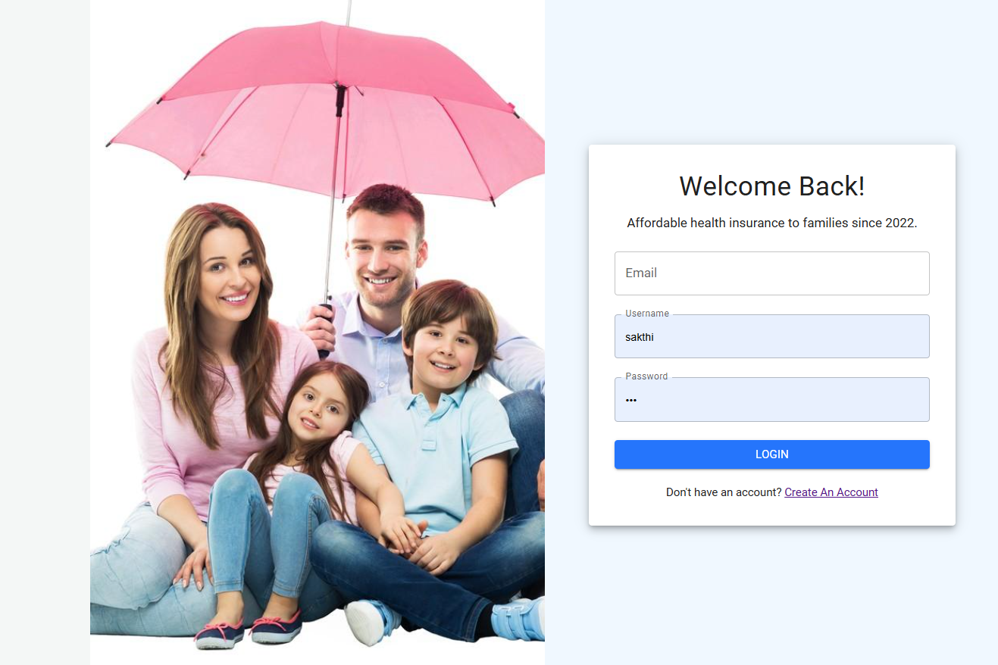

FRONT END- LIFE INSURANCE PORTAL

Slide 8


Slide 9
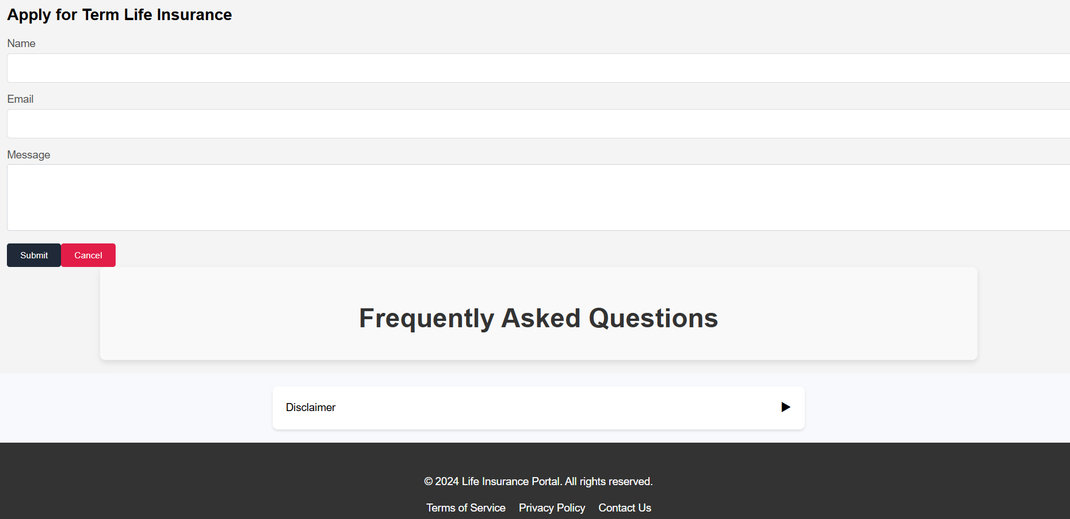

Slide 10
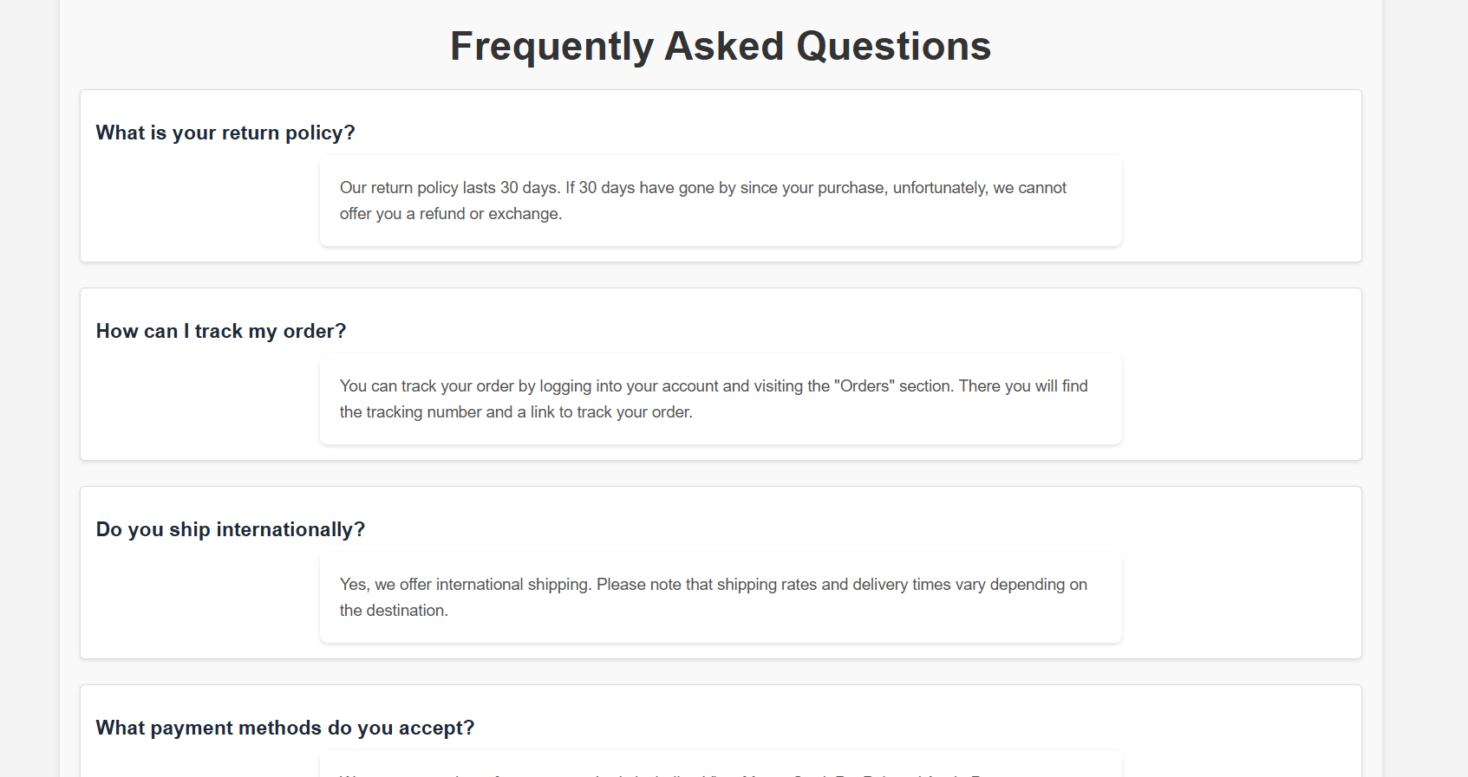

Slide 11


Slide 12
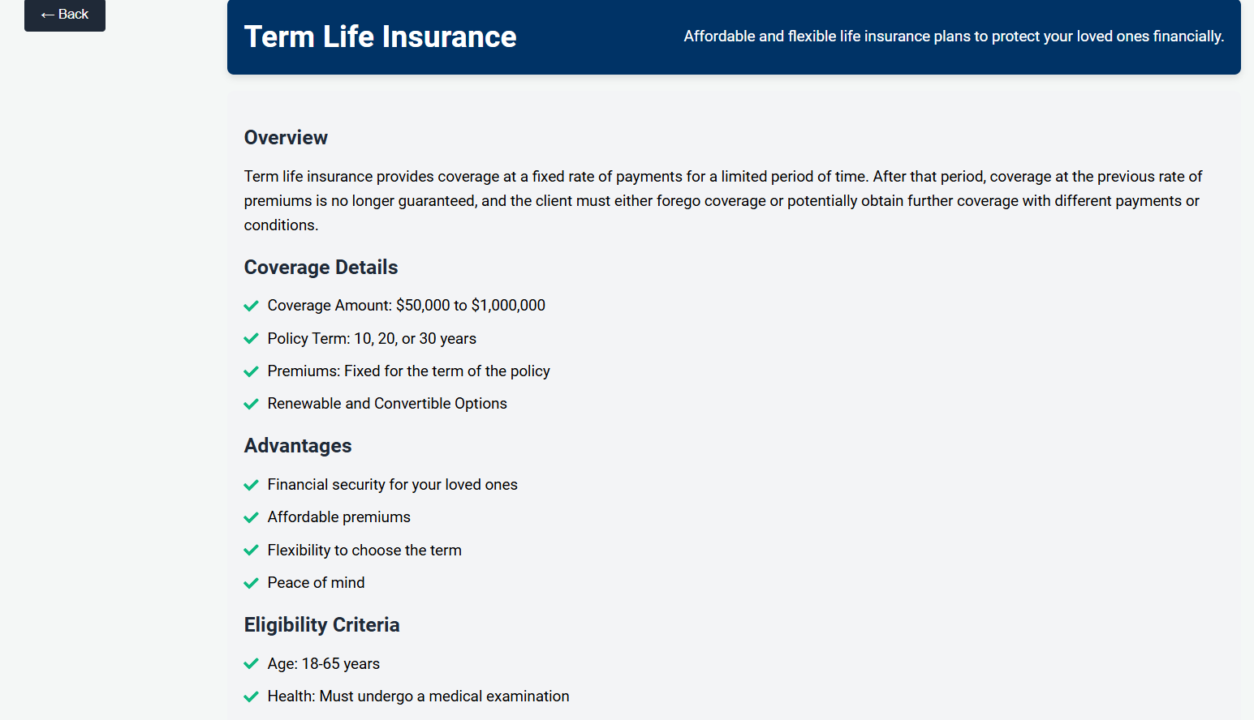
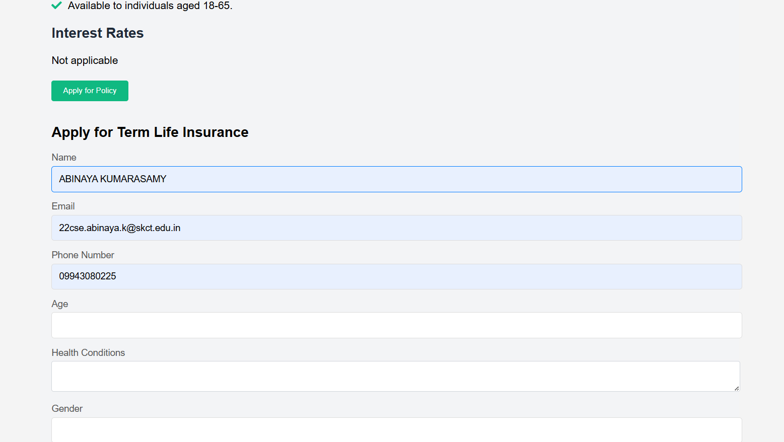

Slide 13


Slide 14
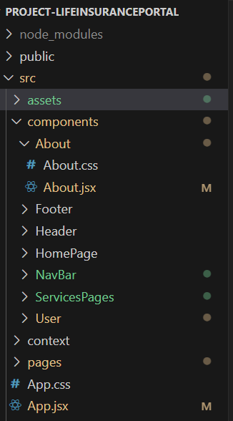
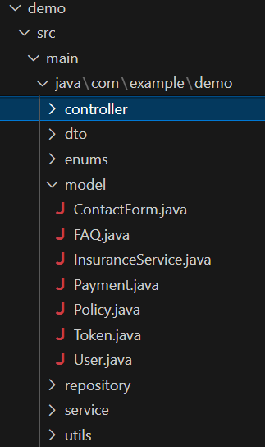
back END
FRONT END

Slide 15
SPRING BOOT
Framework for building production-ready Java applications.
Spring Boot makes building Java apps easier by setting up everything you need automatically.
It includes built-in servers to run your app, tools to monitor its health, and simple ways to manage data and security.
With features like automatic configuration and easy project setup, Spring Boot helps you get your app up and running quickly.

Slide 16
CRUD OPERATION
CRUD operations are basic actions you can perform on data in a database:
Create: Add new data (e.g., a new insurance policy).
Read: Retrieve and view existing data (e.g., check details of a policy).
Update: Modify existing data (e.g., change policy details).
Delete: Remove data (e.g., delete an outdated policy).

Slide 17
Folders used
MODEL
It defines the structure of data objects and their relationships. In the Vehicle Repair Hub, models such as User, Service, Booking, and Admin
REPOSITORY
The Repository is responsible for data access and manipulation providing methods to perform CRUD (Create, Read, Update, Delete) operations on the data.
SERVICE
The Service layer contains the business logic of the application. It orchestrates interactions between the Model and Repository layers and implements the core functionalities of the application
CONTROLLER
The Controller handles HTTP requests and responses, acting as an intermediary between the user interface and the Service layer

Slide 18
SPRING JPA
Simplifies Data Access: Provides an easy way to interact with databases using repositories.
Reduces Boilerplate Code: Automatically generates SQL queries and handles CRUD operations.
Entity Management: Maps Java objects to database tables with annotations.
Advanced Queries: Supports custom queries and query derivation from method names.

Slide 19
SPRING SECURITY
Authentication: Manages user login and verifies identities.
Authorization: Controls access to resources based on user roles and permissions.
Protection: Guards against common security threats like CSRF, XSS, and SQL injection.
Customizable Security: Allows configuration of security rules and authentication methods.

Slide 20
axios
Axios is a JavaScript library for making HTTP requests, offering a promise-based API for handling GET, POST, PUT, and DELETE operations.
It simplifies working with APIs by automatically transforming JSON data, handling errors, and supporting both browser and Node.js environments.
Key Features
Promise-Based: Simplifies asynchronous code with promises.
Supports HTTP Methods: Handles GET, POST, PUT, DELETE, etc.
Automatic JSON Transformation: Converts JSON responses automatically.
Interceptors: Allows modification of requests and responses.
Error Handling: Built-in mechanisms for managing errors.

Slide 21
FUTURE SCOPE
AI Integration: Personalized recommendations and support.
User Experience: Improved interfaces and mobile apps.
Blockchain Security: Enhanced transparency and efficiency.
Big Data Analytics: Tailored products and trend prediction.
IoT Integration: Real-time risk assessment.
Expanded Coverage: New products and options.
Global Expansion: Adaptation to international markets.
Customer Education: Tools and resources for better understanding.
Automated Claims: Faster processing and fraud detection.
Financial Planning Integration: Comprehensive financial solutions.

Slide 22
THANK YOU!!
"Life insurance is not just a financial tool; it's a legacy of love and protection for those you care about most.“
— Anonymous

